Slide 1

SKNSITS Department Of Computer Engineering “Big Mart Sales Predication using Machine Learning” Class:-BE Academic Year:2022-23 Sub:- Project Presentation (2019 Course) Sub Code: 410248 Presented by Name of Group Members : Manmohan Kumar Chandani Lachke Angatjot Singh Name of Guide Nilesh Kumawat Rutvik Nanavare

Slide 2


Slide 3
Contents
Objectives
Introduction
Problem Defination & Scope
Advancement in Technology Pertaining to the selected project topic
Literature review
Software Requirement Specification
Model
Test Case
Output
Conclusion
Reference

Slide 4
Objectives
The objective is to create a model that can predict the sales per product for each store. Using this model, BigMart will try to understand the properties of products and stores which play a key role in increasing sales.

Slide 5
Introduction
Global malls and stores chains and the increase in the number of electronics payments customers ,the competition among the rival organizations is becoming more serious day by day.
Each organization is trying to attract more customers using personalized and short-time offers which makes the predication of future volume of sales of every item an important asset in the planning and inventory of every organization ,transport service, etc.

Slide 6
Problem Defination & Scope
Regression is an important machine learning model for these kinds of problems . predicting sales of a company needs time series data of that company and based on that data the model can predict the future sales of that company or product.
So, in this research project we will analyze the time series sales data of a company and will predict the sales of the company for the coming quarter and for a specific product.
For this kind of project of sales predict , we will apply the linear regression ,logistic regression and XGBoost regression and evaluate the result based on the training , testing and validation set of the data.

Slide 7
Literature Review
Kadam,et.al [1] have suggested when the prediction for the sales for bigmart was doneusingthe algorithm like random forest and LR for prediction analysis it gave lesser accuracy.Sotoovercome this problem we can use another algorithm which is XG boost algorithmwhichnot only gives better accuracy but also is more efficient.
Makridakis, et.al [2] have suggested predicting methods and applications containingDataLack and short life cycles. So some data like historical data, consumer-focused markets faceuncertain needs, which can be an accurate predictor of outcome.
C. M. Wu , et.al [3] have suggested comparison of Different ML Algorithms for MultipleRegression on Black Friday Sales Data used the concept of neural network to comparethevarious different algorithms.Using neural network as the concept which is very complexandless efficient concluded that we should use much simpler algorithm for the prediction purpose.
Das, et.al [4] have suggested in the prediction of retail sales of footwear which used recurrent Neural Networks and feed forward used the neural network to predict the sales.Usingneural network for predicting the sales which is not an efficient method so XGboost algorithmcanbeused.
S. Cheriyan, et.al [5] have suggested in the study they implemented three ML algorithmsonthe given dataset and the models for evaluating the performance. Based upon the testingthealgorithm which gave maximum accuracy was chosen for the prediction which was foundtobe a gradient boosting algorithm.
A. Krishna, et.al[6] have suggested that both the normal regression and boosting algorithmswere implemented and found out that boosting algorithms have better results than the regularalgorithms.

Slide 8
SRS(Software Requirement Specification)
Hardware Requirements
System: i3 processor
Hard Disk : 500 GB.
Input Devices: Keyword ,Mouse
Ram : 4GB
Software Requirements
Operating System: Windows 10.
Coding Language: Python 3.8
Python Libraries : Numpy, Pandas, Matplotlib, Machine Learning Techniques

Slide 9
XGBoost Algorithm
Extreme Gradient Boosting is an one of the most popular and widely used machine learning algorithms due to its ability to handle large datasets and its ability to achieve state-of-the-art performance in many machine learning tasks such as classification and regression.
One of the key features of XGBoost is its efficient handling of missing values, which allows it to handle real-world data with missing values without requiring significant pre-processing. Additionally, XGBoost has built-in support for parallel processing, making it possible to train models on large datasets in a reasonable amount of time.
XGBoost can be used in a variety of applications, including Kaggle competitions, recommendation systems, and click-through rate prediction, among others.

Slide 10
Data
Data Pre-processing
Decomposition of training &Testing Data
Data Exploration
Feature Engineering
Machine Learning Algorithm
Model
Model Evaluation & Trunning Of Model
Model of big mart sales predication

Slide 11
Variable | Description
Item_Identifier | Unique product ID
Item_Weight | Weight of product
Item_Fat_Content | Whether the product is low fat or not
Item_Visibility | The % of total display area of all products in a store allocated to the particular product
Item_Type | The category to which the product belongs
Item_MRP | Maximum Retail Price (list price) of the product
Outlet_Identifier | Unique store ID
Outlet_Establishment_Year | The year in which store was established
Outlet_Size | The size of the store in terms of ground area covered
Outlet_Location_Type | The type of city in which the store is located
Outlet_Type | Whether the outlet is just a grocery store or some sort of supermarket
Item_Outlet_Sales | Sales of the product in the particulat store. This is the outcome variable to be predicted.

Slide 12
Data processing and methodology
Data Collection:
We have collected the data securely in accordance with an agreed methodology. The procedure for the collected data may differ from client to client and is dependent on the type, quantity, availability and need of data.

Slide 13
Data Cleaning and Preprocessing:
The collected data is passed through a ‘cleaning’ process, so as to make sure that the data is segregated properly and identified gaps in the data are filled with the appropriate information, making data compatible and also fixing errors in storage systems which can cause data redundancy.

Slide 14
Feature Engineering:
Feature Engineering is like pre-processing in Machine Learning. The main aim of this feature engineering is to boost the performance of Machine Learning Modals.

Slide 15
Data Modeling :
This is primarily a process in which the given dataset and the objects in it are analyzed to get a clear view of the requirements that may help us support our business model. Based on the analysis on patterns present in the data, models are then created on the established flow of the project. This flow offers a better assistance in the utilization of the previously agreed upon semi-formal model that showcases the features of the project. It also provides guidance to follow the relation between the data objects and other objects.

Slide 16
Data Prediction:
Machine Learning prediction models are trained in this process and then later on evaluated using the data. This will then be applied to the preprocessed dataset. Some of the Models to be used for the prediction are:
▪ Linear Regression
▪ Random Forest
▪ Decision tree
▪ XG Boost Regressor

Slide 17
Data Visualization:
Data Analyzed is then further picturized for customers and the admin to reach out conclusions and take effective decisions.

Slide 18
Model Building:
Once our data set is ready to use then a predictive machine learning model is built by learning from training data.
XG Booster XG Boost stands for eXtreme Gradient Boosting. This is an efficient ensemble method of learning which makes use of a gradient boosting framework. In this model, decision trees are created in the form of a sequence. It is a combination of weak learners to improve prediction accuracy.

Slide 19
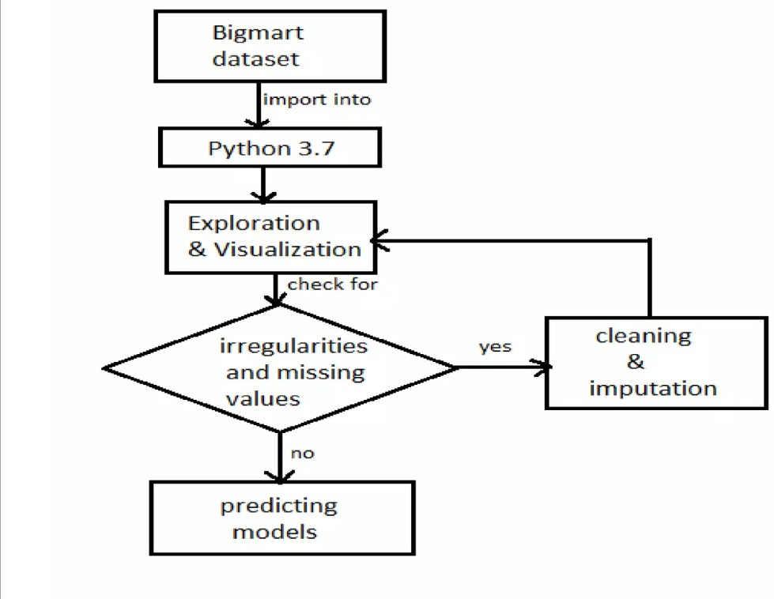
Proposed Work

Slide 20
Testcase
Test case id | Test Carried out | Expected case | Expected result | Actual result
1 | click the link | open web page | Web page opens | pass
2 | enter the data | data gets acaccepted cepted | data shows up | pass
3 | clear responses | click reset | responses get clear | pass
4 | Click Submit | prediction page opens | prediction page opens up | pass

Slide 21
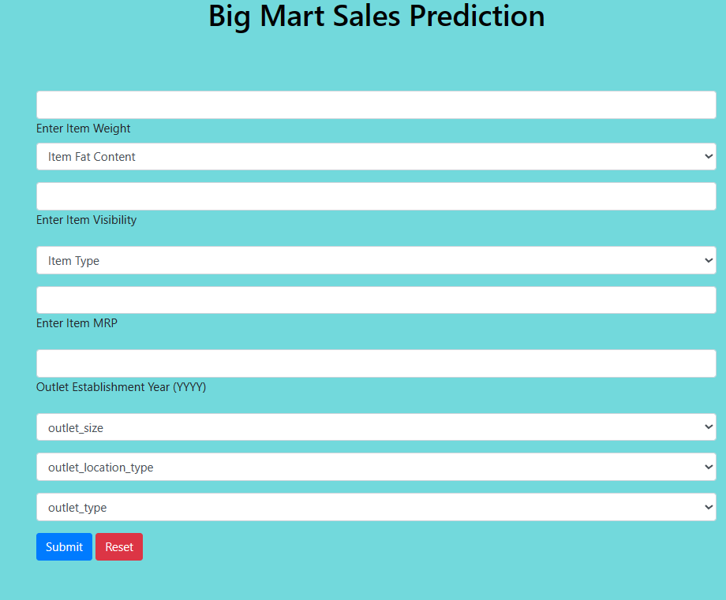
Outcomes

Slide 22
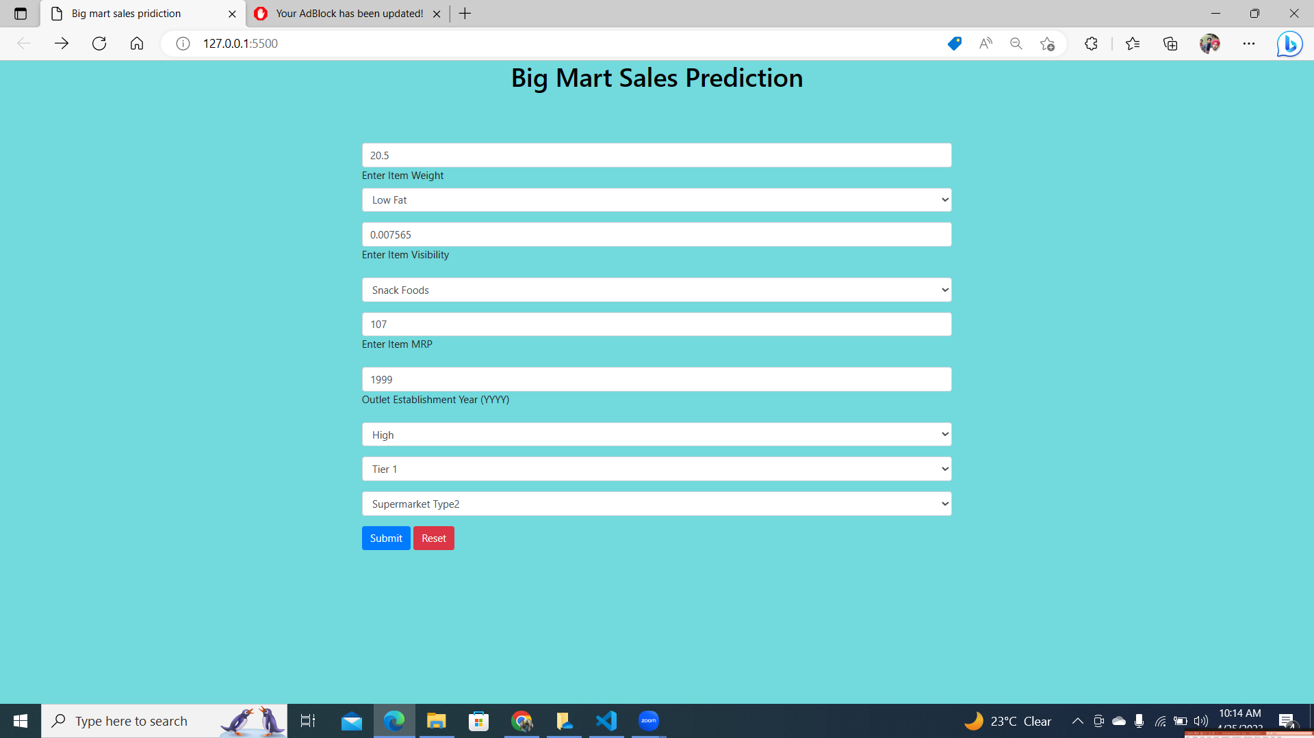
Main Page

Slide 23
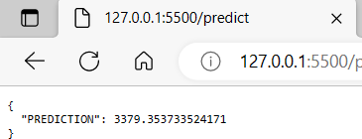
Outcomes

Slide 24
Conclusion
We have applied four algorithms XGBoost, Random Forest, Linear Regression and Decision Tree. From the results, we can conclude that among all the four algorithms XGBoost has the highest accuracy of 61.14% when distinguished together. Hence, we can say that XGBoost is the better algorithm for efficient sales analysis. This methodology is primarily used by shopping marts, groceries, Brand outlets etc. The data analysis applied to the predictive machine learning models provides a very effective way to manage sales, it also generously contributes to better decisions and plan strategies based on future demands . This approach is very much encouraged in today’s world since it aids many companies, enterprises, researchers and brands for outcomes that lead to management of their profits, sales, inventory management, data research and customer demand.

Slide 25
Reference
Rohit Sav, Pratiksha Shinde, Saurabh Gaikwad (2021, June). Big Mart Sales Prediction using Machine Learning.2021 International Journal of Research Thoughts (IJCRT).
Inedi. Theresa, Dr. Venkata Reddy Medikonda,K.V.Narasimha Reddy. (2020, March). Prediction of Big Mart Sales using Exploratory Machine Learning Techniques 020 International Journal of Advanced Science and Technology (IJAST).
Bohdan M. Pavlyshenko (2018, August 25). Rainfall Predictive Approach for La Trinidad, Benguet using Machine Learning Classification. 2018 IEEE Second International Conference on Data Stream Mining & Processing (DSMP).
Pavan Chatradi, Meghana, Avinash Chakravarthy V, Sai Mythri Kalavala , Mrs.Neetha KS (2020), Improvizing Big Market Sales Prediction, Volume 12 Issue 4 Gopal Behere, Neeta Nain (2019). Grid Search Optimization (GSO) Based Future Sales Prediction for Big Mart. 2019 International Conference on Signal-Image Technology & Internet-Based Systems (SITIS).
Kumari Punam , Rajendra Pamula , Praphula Kumar Jain (2018, September 28-29). A Two-Level Statistical Model for Big Mart Sales Prediction. 2018 International conference on on Computing, Power and Communication Technologies
Ranjitha P, Spandana M. (2021). Predictive Analysis for Big Mart Sales Using Machine Learning Algorithms.Fifth International Conference on Intelligent Computing and Control Systems (ICICCS 2021).
Bohdan M. Pavlyshenko (2018, August 25). Rainfall Predictive Approach for La Trinidad, Benguet using Machine Learning Classification. 2018 IEEE Second International Conference on Data Stream Mining & Processing (DSMP)

Slide 26
THANK YOU

